Slide 1

Dynamic Programming
CAPSTONE project
CSA0650-Design and Analysis of Algorithms for Amortized Analysis
-Split Array With Same Average
Done By
P. Vijaya Lakshmi
Reg. No: 192210200
Supervisor:
Dr. Dhanalakshmi

Slide 2
Problem Statement
Split Array With Same Average
You are given an integer array nums.
You should move each element of nums into one of the two arrays A and B such that A and B are non-empty, and average(A) == average(B). Return true if it is possible to achieve that and false otherwise. Note that for an array arr, average(arr) is the sum of all the elements of arr over the length of arr.
Example 1:
Input: nums = [1,2,3,4,5,6,7,8]
Output: true
Explanation: We can split the array into [1,4,5,8] and [2,3,6,7], and both of them have an average of 4.5.

Slide 3
Abstract
The problem of splitting an integer array nums into two non-empty subarrays A and B such that they have the same average is approached using a dynamic programming strategy combined with mathematical insights.
Key to the solution is recognizing that for two arrays with equal averages, the difference between their total sums must be a multiple of the average. By leveraging a set to store possible sums achievable with elements from nums, the algorithm efficiently determines if such a split is feasible. This approach ensures that potential splits are validated through mathematical conditions derived from the properties of averages and integer sums.

Slide 4
Introduction
Given an integer array nums, the task is to partition its elements into two non-empty subsets A and B such that both subsets have the same average. The average of a subset X is defined as the sum of its elements divided by the number of elements in X.
For instance, given nums = [1, 2, 3, 4, 5, 6, 7, 8], it's possible to split the array into subsets [1, 4, 5, 8] and [2, 3, 6, 7], both of which have an average of 4.5.
The challenge is to determine if such a partitioning is feasible for any given array nums and return true if possible, otherwise false. To solve this problem efficiently, we leverage mathematical properties of averages and employ a dynamic programming approach to explore possible subset combinations that can achieve the required conditions.

Slide 5
Algorithm
Bit masking in dynamic programming is a technique used to represent and manipulate subsets efficiently using binary numbers (bits).
Each bit in a binary number can represent the presence (1) or absence (0) of an element in a subset, making it a powerful tool for solving problems that involve combinations of elements.
Each subset is represented by a binary number where each bit indicates whether a particular element is included in the subset.
Using bit masks allows for efficient enumeration of all subsets of a set, which is particularly useful in problems involving combinations and permutations.
Using this method many complex problems like Travelling Sales Man problem were Solved.

Slide 6
Coding
dfs(nums2, 0, 0, 0, true);
int sz1 = nums1.size();
int sz2 = nums2.size();
for (int cnt1 = 0; cnt1 <= sz1; cnt1++) {
for (int sum1 : dp1[cnt1]) {
for (int cnt2 = 0; cnt2 <= sz2; cnt2++) {
if (cnt1 + cnt2 == 0 || cnt1 + cnt2 == n) continue;
int targetSum = (sum * (cnt1 + cnt2) / n) - sum1;
if (dp2[cnt2].count(targetSum)) {
return true;
}
}
}}
return false;
}
};
int main() {
Solution sol;
vector<int> nums = {1, 2, 3, 4, 5, 6, 7, 8};
cout << (sol.splitArraySameAverage(nums) ? "True" : "False") << endl;
return 0;
}
#include <iostream>
#include <vector>
#include <numeric>
#include <unordered_map>
#include <unordered_set>
using namespace std;
class Solution {
public:
unordered_map<int, unordered_set<int>> dp1, dp2;
void dfs(vector<int>& nums, int i, int sum, int cnt, bool part) {
if (i == nums.size()) {
if (part) {
dp2[cnt].insert(sum);
} else {
dp1[cnt].insert(sum);
}
return;
}
dfs(nums, i + 1, sum, cnt, part);
dfs(nums, i + 1, sum + nums[i], cnt + 1, part);
}
bool splitArraySameAverage(vector<int>& nums) {
int n = nums.size();
if (n == 1) return false;
int sum = accumulate(nums.begin(), nums.end(), 0);
vector<int> nums1(nums.begin(), nums.begin() + n / 2);
vector<int> nums2(nums.begin() + n / 2, nums.end());
dfs(nums1, 0, 0, 0, false);

Slide 7
Output

Slide 8
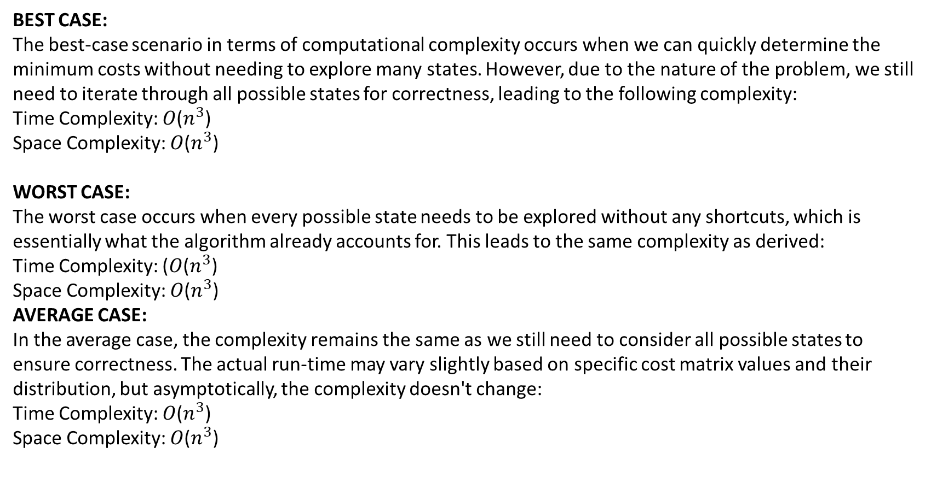
BEST CASE:
The best-case scenario in terms of computational complexity occurs when we can quickly determine the minimum costs without needing to explore many states. However, due to the nature of the problem, we still need to iterate through all possible states for correctness, leading to the following complexity:
Time Complexity: 𝑂($n^{3}$)
Space Complexity: 𝑂($n^{3}$)
WORST CASE:
The worst case occurs when every possible state needs to be explored without any shortcuts, which is essentially what the algorithm already accounts for. This leads to the same complexity as derived:
Time Complexity: (𝑂($n^{3}$)
Space Complexity: 𝑂($n^{3}$)
AVERAGE CASE:
In the average case, the complexity remains the same as we still need to consider all possible states to ensure correctness. The actual run-time may vary slightly based on specific cost matrix values and their distribution, but asymptotically, the complexity doesn't change:
Time Complexity: 𝑂($n^{3}$)
Space Complexity: 𝑂($n^{3}$)

Slide 9
Conclusion
In conclusion, solving the problem of splitting an array nums into two subarrays A and B such that they have the same average requires careful consideration of arithmetic properties and dynamic programming techniques:
Arithmetic Insight: The key insight is that for two arrays A and B to have the same average, their respective sums multiplied by the length of the other array should be equal.
Dynamic Programming Approach: We use a dynamic programming approach to keep track of all possible sums that can be achieved by subsets of the array. This allows us to efficiently check if there exists a subset whose sum, when adjusted for length, matches the required condition.
Implementation Strategy: The solution involves initializing with a set of possible sums (starting with {0}), iterating through each element to update the set of possible sums dynamically, and finally checking through the possible sums to find a valid split that satisfies the condition.
Efficiency: The approach leverages dynamic programming to build up solutions incrementally, ensuring that the solution is efficient both in terms of time complexity and space complexity.

